Slide 1
UGP
END TERM PRESENTATION
SNEHAL S. KANE
211044

Slide 2
WEEK 1 (4/1/24 - 12/1/24)
Subject – Investigating existing subsequence search models.
Various methods which are employed for subsequence searching:
Text Extraction and analysis – Text extraction includes preprocessing the data of the text like tokenising, stemming, lemmatization, stop word removal etc. So we reduce our text to a more concentrated, decoded version of itself from where pattern identification will be faster. Natural Language Toolkit (NLTK) Tokenizer, spaCy Tokenizers are some examples.
Indexing and Full Text Search – Much like tokenising, inverted indexing is the most common of the indexing techniques for full text search. Once a search query is generated, the query is looked up in the inverted indexing to find relevant matches. The system may assign scores to documents based on the relevance of the terms and their positions in the documents.
Regex (Regular Expression) Search

Slide 3
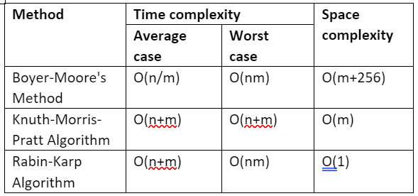
3 major algorithms for exact subsequence searching and their working :
Boyer Moores Algorithm - Involves back searching, preprocessing for last occurence and matching. Has 2 methods Bad Character and Good Suffix (usually for smaller patterns)
Knuth-Morris-Pratt (KMP) Algorithm - Employs a Prefix table called as LPS (Longest Proper Prefix which is also a Suffix) and then 2 pointers. Preprocesses pattern.
Rabin-Karp Algorithm - The pattern and the text are given Hash values (sliding window algorithm)
n = length of text m = length of pattern
Notes:
Boyer moore - bad character → https://www.geeksforgeeks.org/boyer-moore-algorithm-for-pattern-searching/
- good suffix → https://www.geeksforgeeks.org/boyer-moore-algorithm-good-suffix-heuristic/
KMP → https://www.geeksforgeeks.org/kmp-algorithm-for-pattern-searching/

Slide 4
Overall results → The Rabin Karp algorithm is the slowest matching algorithm in all cases because it does not use a mismatch table. Boyer Moore was second in most cases as it used a mismatch table when there was any mismatch. The fastest algorithm was the Knuth-Morris-Pratt algorithm.
Different approximate search algorithms used in Bioinformatics -
BLAST (Basic Local Alignment Search Tool) - Uses heuristics and Dynamic Programming (DP). It performs sequence similarity searches by finding local alignments between a query sequence and sequences in a database.
Suffix Trees and Suffix Arrays - These data structures store all suffixes of a sequence, enabling rapid searches and queries.
Burrows-Wheeler Transform (BWT) and FM Index - BWT rearranges the sequence to improve compression, and the FM index enables fast searches without explicitly storing the entire index.
Hidden Markov Models (HMMs) - HMMs are probabilistic models that identify the subsequences with specific characteristics.
Notes:
BWT - https://www.geeksforgeeks.org/burrows-wheeler-data-transform-algorithm/

Slide 5
WEEK 2 (13/01/24 - 20/01/24)
Subject – Approximate search models.
Basic working of the model -
Edits - The closeness of a match is measured in terms of the number of primitive operations necessary to convert the string into an exact match. This number is called the edit distance between the string and the pattern.
insertion: cot → coat
deletion: coat → cot
substitution: coat → cost
Preprocessing the available text (using trie, hash tables etc.)
Calculating the edit distance (levenshtein distance using Thefuzz (FuzzyWuzzy) etc)
Ranking different matches (how?)
Show top matches
Each type of Edit can have different cost, depending on how we set it.
Notes:
We can add limit to our cost and then limit the answers we receive.

Slide 6
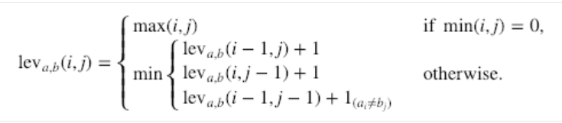
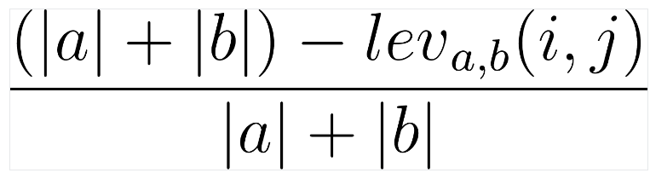
Fuzzy Algorithms :
Hamming distance - It describes the minimum amount of substitutions required to transform s1 into s2. For hamming distance comparison, two strings need to be of the same length.
Levenshtein distance -
The rows on the minimum above correspond to a deletion, an insertion, and a substitution in that order. It is also possible to calculate the Levenshtein similarity ratio based on the Levenshtein distance. This can be done using the following formula :
N-gram Algo (Tri-grams) -
BK Tree Algo -
Jaro Similarity - The similarity between two strings is normalized, 0 is least and 1 is most similar. It depends on the intersection of characters, length of the two strings and the number of transpositions to match the string.
where |a| and |b| are the lengths of a sequence and b sequence, respectively.
Notes:
→https://www.kdnuggets.com/2020/10/optimizing-levenshtein-distance-measuring-text-similarity.html#:~:text=The%20Levenshtein%20distance%20is%20usually,some%20calculations%20within%20each%20iteration.
→ https://medium.com/@ethannam/understanding-the-levenshtein-distance-equation-for-beginners-c4285a5604f0
Let's see how the distance between these 2 subsets is calculated. For a given cell at the location (i,j) corresponding to the intersection between the 2 characters A and B, we compare the values at the 3 locations (i,j-1), (i-1,j), and (i-1,j-1). If the 2 characters are identical, then the value at location (i,j) equals the minimum of the mentioned 3 locations. Otherwise, it will be equal to the minimum value at those 3 locations after adding 1.

Slide 7
In all fuzzy algorithms 2 factors are important, choosing the correct parameter and coming up with fast implementation of the same.
Correct parameter - Since we have audio inputs using a combination of a distance-based score and a phonetic-based encoding is suitable i.e. initially computing a score based on the Levenshtein distance and later using Metaphone or Double Metaphone to complement the results.
Fast implementation - Clustering our data into several small groups based on your use case and load them into a dictionary. For example, If you can assume that your user enters the first letter of the name correctly, you can store the names based on this invariant in a dictionary.
-----------------------------------------------x-----------------------------------------------
Notes:
So, if the user enters the name "National School" you need to compute the fuzzy matching score only for school names starting with the letter "N".

Slide 8

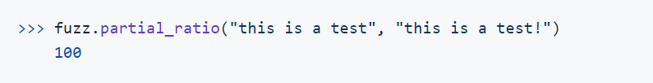
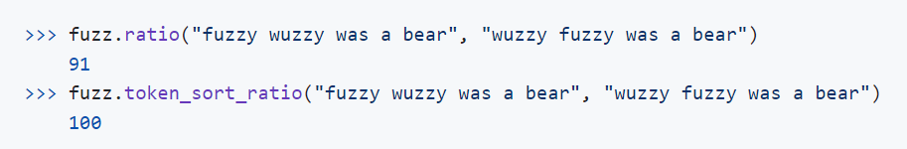
TheFuzz (previously FuzzyWuzzy) :
TheFuzz uses the Levenshtein edit distance to calculate the degree of closeness between two strings. It also provides features for determining string similarity in various situations. (All ratios use Levenshtein Distance to calculate ratios).
Simple Ratio - This simply calculates the edit distance based on the ordering of both input strings difflib.ratio() – see the difflib documentation to learn more.
Partial Ratio - The partial_ratio() calculates the similarity by taking the shortest string, which in this scenario is stored in the variable name, then compares it against the sub-strings of the same length in the longer string, which is stored in full_name.
Token Sort Ratio - Token sort doesn’t care about what order words occur in. It accounts for similar strings that aren’t in order as expressed above. Token sort only disregards order. If there are words that are dissimilar words in the strings, it will negatively impact the similarity ratio.

Slide 9
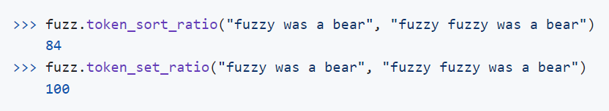
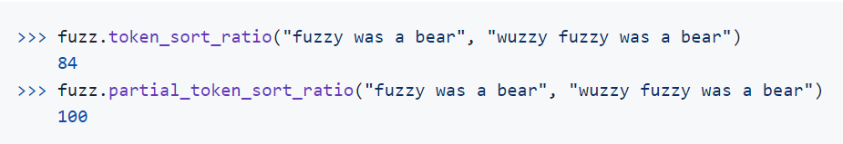
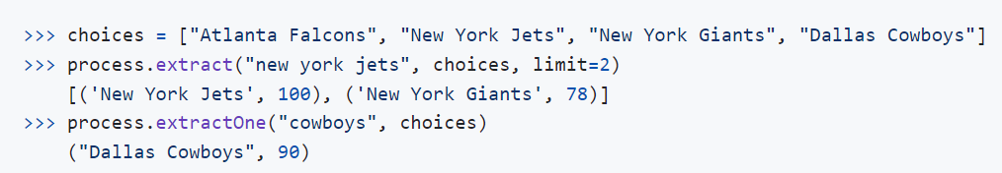

Token Set Ratio - The token_set_ratio() method is pretty similar to the token_sort_ratio(), except it takes out common tokens before calculating how similar the strings are: this is extremely helpful when the strings are significantly different in length.
Partial Token Sort Ratio
Process - The process module enables users to extract text from a collection using fuzzy string matching. Calling the extract() method on the process module returns the strings with a similarity score in a vector. We can control the length of the vector returned (the edit distance ig) by the extract() method by setting the limit parameter to the desired length.
Wratio — compares the complete string without taking into consideration the case of the string and some special characters.

Slide 10
WEEK 3 (21/01/24 - 03/02/24)
Subject – Fuzzy library (Thefuzz).
Thefuzz actual repo --> https://github.com/seatgeek/thefuzz/blob/master/thefuzz/fuzz.py#L21 It is a Python library which has been originally developed by SeatGeek. The core method being used here is the calculation of Levenshtein Distance between two strings.
Calculating Ratio from Levenshtein distance - The Levenshtein ratio is calculated by dividing the Levenshtein distance by the maximum of the length of the string1 and string 2.
Eg - HOUSE and MOUSE → LD = 1 so RATIO = 1/max(5,5) = ⅕ = 20
Understanding the git repo -
.py → These files contain actual Python code that is meant to be executed.They may include functions, classes, and other executable code.When you run a Python program, it is typically the .py files that are executed.
.pyi → Static type hinting in Python involves adding type information to your code to help tools and developers catch potential errors and improve code understanding without actually executing the code.
__init__.py → The __init__.py file serves a special purpose in Python and is used to indicate that a directory should be treated as a Python package.
Explanation of code from Word doc
Notes:
Rapidfuzz → https://medium.com/@kasperjuunge/rapidfuzz-explained-c26e93b6012d
→ https://shahparthvi22.medium.com/all-about-rapidfuzz-string-similarity-and-matching-cd26fdc963d8

Slide 11
WEEK 4 (04/02/24 - 12/02/24)
Subject – Using examples : Which ratio suits best to which error(spelling)
To run test cases there are 3 broad parameters -
Ratio type
Query type (length and extent of errors)
Error type
Usually in all egs we saw that (Query len) = (Text len) to obtain a reasonable ratio. If (Query len << Text len) && (Query lens to be individually comparable) then ratios are bound to be small but we can compare them to get the maximum one.
So here I keep the query constant and calculate all 6 Ratios for different errors that I add in the Query.

Slide 12
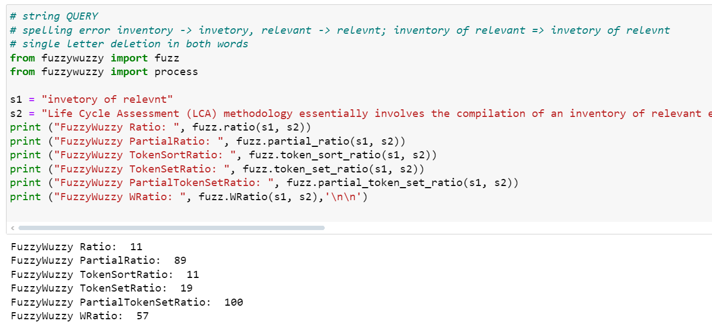
Deletion Errors - (i) Single word Query
Results - Partial Ratio(PR) was best performing followed by Partial Token Set Ratio (PTSR)
Peculiarity 1 - with a letter in a case → word = inventory
For deleting any letter the PR stayed on 100 unless I touched ‘r’. Upon removing it the ratio changes.
So until we change ‘r’ PR > PTSR but after changing ‘r’ PTSR > PR

Slide 13
- (ii) String Query
Results - In general Partial Token Set Ratio is good followed by Partial Ratio
- For strings with 3 words a peculiar thing was observed:
(a) Changing only 1st and 3rd words => PR < PTSR
(b) Changing 2nd word with (a) such that the (changed 2nd word) is or is not a subset of (original 2nd word) => PR > PTSR
Peculiarity 2 - In string queries for all queries PTSR>PR except when middle word was changed.
Peculiarity 3 - Although PR performed good for single word queries, no ratio gave 100 result for any approximate query whereas for some approximate string queries PTSR gave 100 result.
Tried Addition and Substitution errors next

Slide 14
WEEK 4 (13/02/24 - 29/02/24) Pre Midsem and Midsem week. To find the working of TheFuzz library, incorporated them in previous weeks.
WEEK 5 (01/03/24 - 08/03/24)
Subject – AGREP research paper.
Introduction and Uses -
The most common string-searching problem is to find all occurrences of a string P =p1,p2...pm, inside a large text file T=t1,t2…tn.
Here throughout we assume the string and text to be part of a finite character set ‘G’ (sigma).
The 3 distinctive features of agrep (not supported by grep) are - (i) Searching for approximate patterns (ii) searching for records rather than just lines (iii) searching for multiple patterns with AND (or OR) logic queries.
Refer PDF for egs.

Slide 15
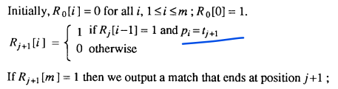
AGREP : Algorithms -
Arbitrary patterns with errors
Algorithm for Multi Patterns (not for approx search)
Arbitrary patterns with errors
Let R be a bit array of size m (the size of the pattern). We denote by Rj the value of the array R after the j character of the text has been processed. The array Rj contains information about all matches of prefixes of P with a suffix of the text that ends at j. More precisely, Rj[i]=1 if the first i characters of the pattern match exactly the last i characters up to j in the text. The transition from Rj to R(j+1) :

Slide 16
Steps -
However, suppose that m <32 (which is usually the case in practice), and that R is represented as a bit vector using one 32-bit word. For each character si in the alphabet we construct a bit array Si of size m such that Si[r]=1 if pr=si.{It is sufficient to construct the S arrays only for the characters that appear in the pattern.)
Now that the transition from Rj to Rj+1, amounts to no more than a right shift of Rj and an AND operation with Si,where si=tj+1;. So, each transition can be executed with only two simple arithmetic operations, a shift and an AND.
Suppose now that we want to allow one substitution error. We introduce one more array, denoted by R’,which indicates all possible matches up to tj; with at most one substitution. The transition for the R array is the same as before. We need only to specify the transition for R’. There are two cases for a match with at most one substitution of the first i characters of P up to tj+1 :

Slide 17
S1. There is an exact match of the first i-1 characters up to tj. This case corresponds to substituting tj+1 with pi (whether or not they are equal — the equality will be indicated in R) and matching the first i—1 characters.
S2. There is a match of the first i-1 characters up to tj with one substitution and tj+1 =pi.
If we want to allow more than one error, then we maintain more than one additional R’ array. Overall, the number of operations is proportional to the number of errors.
—---- Suppose again that the pattern P is of size m and that at most k errors are allowed. Let r =m/(k+1) divide P into k+1 blocks each of size r and call them P1, P2, ..., Pk+1. If P matches the text with at most k errors, then atleast one of the Pj’s must match the text exactly. We can search for all Pj’s at the same time (by using a combined interleaved pattern, see in pdf) and, if one of them matches, then we check the whole pattern directly (using the R’ array) but only within a neighborhood of size m from the position of the match (say i is match position so i- M +k to i+M+k-m is the ‘candidate’ area).
Notes:
See 2nd Algo - Algo for Multi Patterns from pdf

Slide 18
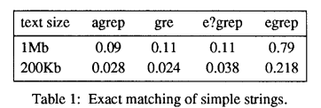
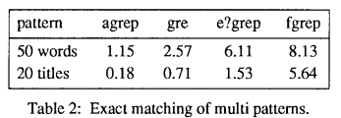
Experimental results
Table 1 compares agrep against other programs for exact string matching. The first three programs use Boyer-Moore type algorithms. The original egrep does not. We used 50 words of varying sizes (3-12) as patterns and averaged the results.
Table 2 shows results of searching for multi patterns. In the first line the pattern consisted of 50 words (the same words that were used in Table 1, but all in once) searched inside a dictionary; in the second line the pattern consists of 20 separate titles (each two words long), searched in a bibliographic file.

Slide 19
Conclusions
Agrep seems better for multi patterns. For approximate matching, agrep is one to two orders of magnitude faster than other programs that we tested. We believe that the main strength of agrep is that it is more flexible, general, and convenient than all previous programs.
Agrep is very fast and general and it should find numerous applications. It has already been used in the Collaboratory system [HPS90], in a new tool (under development) for locating files in a UNIX system [FMW92], and in a new algorithm for finding information in a distributed environment [FM92]. In the last two applications, agrep is modified in a novel way to search inside specially compressed files without having to decompress them first.

Slide 20
WEEK 6 (09/03/24 - 17/03/24)
Subject – Comparing AGREP with TheFuzz.
Agrep is available only on linux systems.
WEEK 7 (18/03/24 - 24/03/24) - midterm eval
WEEK 8 (25/03/24 - 31/03/24) - midsem break
WEEK 9 (01/04/24 - 07/04/24) - implementing agrep (wsl)
WEEK 10 (09/04/24 - 15/04/24) - taking in file and implementing fuzzy
WEEK 11 (16/04/24 - 22/04/24) - ground reality
Now, starting post MId term evaluation -
Notes:
https://www.rdocumentation.org/packages/base/versions/3.6.2/topics/agrep

Slide 21
TWO MAJOR METHODS OF APPROXIMATE SEARCH
AGREP
Fuzzy Search
We will compare both on their ability to handle erroneous queries, time taken and accuracy displayed.
Lets first go through the errors. Errors are of different types, here I have considered :
Deletion - Repetition
Substitution - Addition
We will see each one separately by both algorithms.

Slide 22
The INPUTS
Dataset:
1
2
3
Raw Data
Processed Data
AGREP
1000 text files taken from the wikipedia dataset on Hugging Face.
Each file is split from the end of line(.) such that every new sentence starts from a new line.
Apply AGREP on this preprocessed data.
Search Query:
(i) airport (ii)

Slide 23
Code Working
We take processed files one by one as input
Apply AGREP/Fuzzy Search to them
Send output to terminal, WSL for AGREP.
Store the terminal results in a text file

Slide 24
(i) True word - airport
Actual number of occurrences = 20
Actual number of occurrences (case insensitive) = 55
Via GREP (100% accuracy)
ACTUAL WORD
No. of errors (in query) = 0 | Cost/ Distance (allowed no. of output) errors = 0
 |  | airport | airport | airport (case insensitive)
AGREP | NO. OF OUTPUTS | 20 | 20 | 55
 | TIME | 1.36 | 1.35 | 1.34
FUZZY | NO. OF OUTPUTS | 20 | 20 | 20
 | TIME | 0.6 | 0.5 | 0.65

Slide 25
With errors :-

Slide 26
DELETION
No. of errors (in query) = 1 |  | Cost/ Distance (allowed no. of output) errors = 1
 |  | airprt | aiport | airpot
AGREP | NO. OF OUTPUTS | 20 | 22 | 20
 | TIME | 1.37 | 1.34 | 1.35
FUZZY | NO. OF OUTPUTS | 20 | 24 | 20
 | TIME | 0.46 | 0.49 | 0.47
No. of errors (in query) = 1 |  | Cost/ Distance (allowed no. of output) errors = 2
 |  | airprt | aiport | airpot
AGREP | NO. OF OUTPUTS | 116 | 5728 | 134
 | TIME | 1.39 | 1.35 | 1.61
FUZZY | NO. OF OUTPUTS | 128 | 5827 | 176
 | TIME | 3.05 | 3.99 | 3.31
Notes:
Deln
Agrep - 96.96%
Fuzzy - 94%
Ag - 1
F - 0.9

Slide 27
REPETITION
No. of errors (in query) = 2 |  | Cost/ Distance (allowed no. of output) errors = 2
 |  | airrrport | airppport | aairrport
AGREP | NO. OF OUTPUTS | 20 | 20 | 20
 | TIME | 1.42 | 1.58 | 1.42
FUZZY | NO. OF OUTPUTS | 20 | 21 | 20
 | TIME | 0.51 | 0.51 | 0.59
 |  | Cost/ Distance (allowed no. of output) errors = 3
 |  | airrrport | airppport | aairrport
AGREP | NO. OF OUTPUTS | 56 | 58 | 55
 | TIME | 1.53 | 1.46 | 1.25
FUZZY | NO. OF OUTPUTS | 145 | 86 | 141
 | TIME | 5.86 | 5.97 | 5.16
Notes:
rep
Agrep - 100
Fuzzy - 98.4
A - 35.5
F = 16.13

Slide 28
SUBSTITUTION
No. of errors (in query) = 1 |  | Cost/ Distance (allowed no. of output) errors = 1
 |  | airfort | airpork | airpora
AGREP | NO. OF OUTPUTS | 21 | 20 | 20
 | TIME | 1.47 | 1.38 | 1.86
FUZZY | NO. OF OUTPUTS | 21 | 20 | 20
 | TIME | 0.44 | 0.55 | 0.48
 |  | Cost/ Distance (allowed no. of output) errors = 2
 |  | airfort | airpork | airpora
AGREP | NO. OF OUTPUTS | 62 | 61 | 153
 | TIME | 1.50 | 1.75 | 1.37
FUZZY | NO. OF OUTPUTS | 69 | 62 | 155
 | TIME | 3.2 | 3.36 | 3.02
Notes:
subs
Agrep - 98.4
Fuzzy - 98.4
A- 21.7
F - 20.97

Slide 29
ADDITION
No. of errors (in query) = 1 |  | Cost/ Distance (allowed no. of output) errors = 1
 |  | aireport | airtport | airporet
AGREP | NO. OF OUTPUTS | 20 | 20 | 20
 | TIME | 1.37 | 1.38 | 1.33
FUZZY | NO. OF OUTPUTS | 35 | 20 | 20
 | TIME | 0.466 | 0.54 | 0.47
No. of errors (in query) = 2 |  | Cost/ Distance (allowed no. of output) errors = 2
 |  | airenport | airetport | aireporut
AGREP | NO. OF OUTPUTS | 20 | 20 | 20
 | TIME | 1.33 | 1.47 | 1.39
FUZZY | NO. OF OUTPUTS | 35 | 35 | 35
 | TIME | 0.577 | 0.48 | 0.54
Notes:
add
Agrep - 100
Fuzzy - 85.7
A -

Slide 30
(ii) String Query - at the airport
Actual number of occurrences = 1
Actual string
No. of errors = 0 |  | Cost / distance allowed
 |  | Cost = 0 | Cost = 1 | Cost = 2
AGREP | NO. OF OUTPUTS | 0 | 0 | 0
 | TIME | 1.34 | 1.35 | 1.36
FUZZY | NO. OF OUTPUTS | 1 | 1 | 5
 | TIME | 0.47 | 0.47 | 0.55

Slide 31
at th areport
No. of errors = 0 |  | Cost / distance allowed
 |  | Cost = 3 | Cost = 4 | Cost = 5
AGREP | NO. OF OUTPUTS | 0 | 0 | 0
 | TIME | 1.54 | 1.52 | 1.62
FUZZY | NO. OF OUTPUTS | 6 | 41 | 415
 | TIME | 0.50 | 16.67 | 37.30

Slide 32
CONCLUSIONS
No. of errors ~ Cost
 | Accuracy | Time
AGREP | 98.84% | T
Fuzzy | 94.13% | T/3
No. of errors < Cost
 | Accuracy | Time
AGREP | 19.4% | T
Fuzzy | 12.67% | ~2.5T

Slide 33
In general usage when a user doesn’t know his no. of errors, he tends to put cost > no. Of errors so as to get some output. So in such cases AGREP is a preferable option than Fuzzy.
But if we know the no. of errors (not their positions) then cost = no. of eros. In such cases Fuzzy is preferable than AGREP as it requires one third of the time taken by agrep by giving a good accuracy.
So overall Accuracy wise AGREP > Fuzzy
And Time wise too is precise no. of errors unknown then AGREP > Fuzzy

